Slide 1
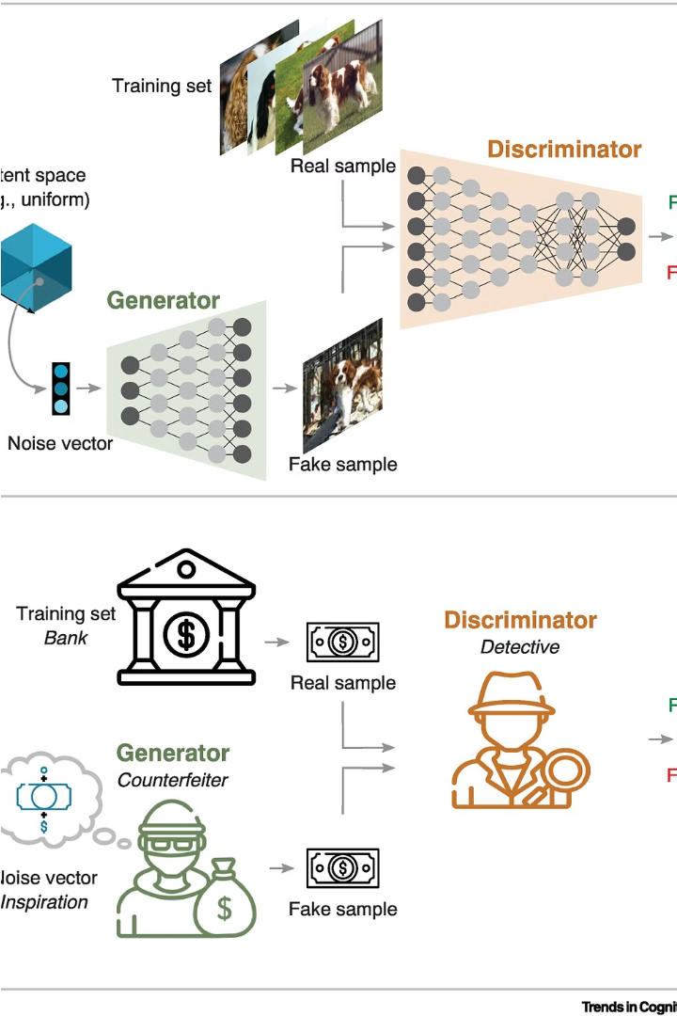


Introduction to GANs
Generative Adversarial Networks (GANs) are a powerful deep learning technique for generating realistic data, such as images, that can be used to enhance and improve visual quality.
by Luvin _007

Slide 2
Understanding Super-Resolution
Increasing image resolution beyond the native sensor's capabilities
Leveraging deep learning models to intelligently upscale low-res images
Preserving important details and reducing artifacts during the upscaling process

Slide 3
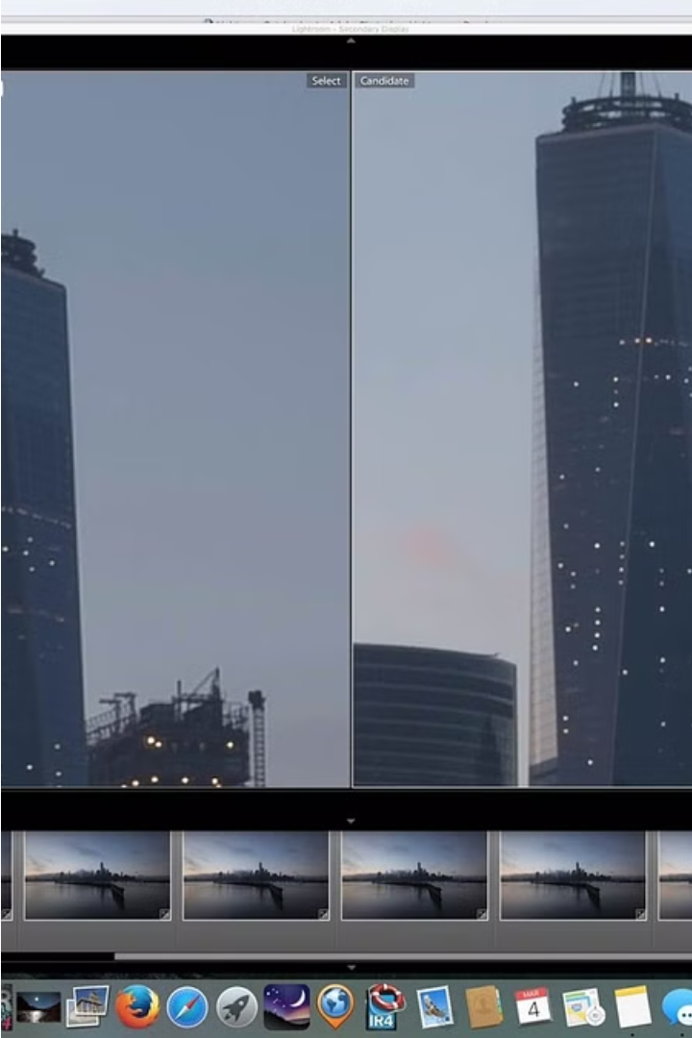
Challenges in Super-Resolution
Preserving fine details and avoiding artifacts during image upscaling is a key challenge.
Dealing with noise and blurriness to maintain image sharpness is another obstacle.
Efficiently processing large image datasets for training super-resolution models can be computationally intensive.

Slide 4
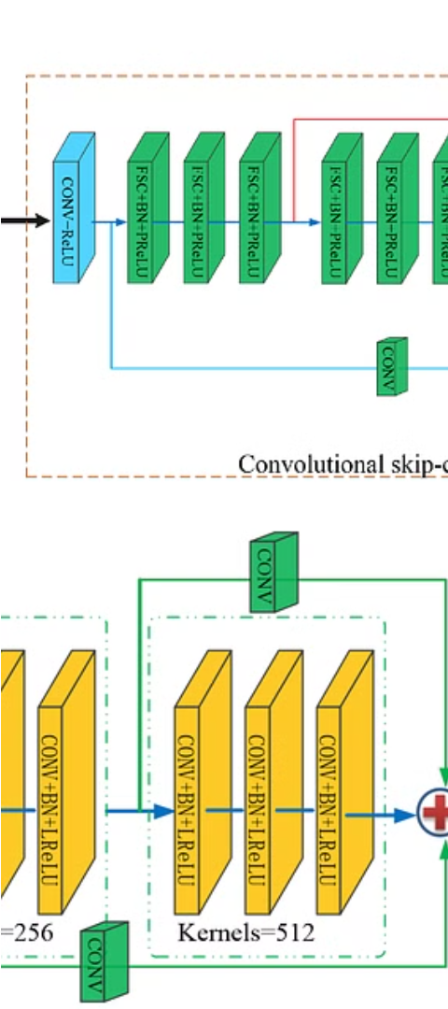
GAN Architecture for Super-Resolution
1
Generator Network
Upsamples low-res input to high-res output
2
Discriminator Network
Distinguishes real high-res images from fakes
3
Adversarial Training
Iterative process to improve both networks

Slide 5
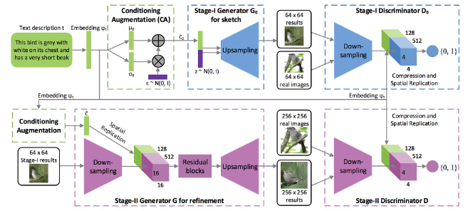
Training GAN Models for Super-Resolution
Train Generative Adversarial Network (GAN) models to enhance low-res images
Utilize generator and discriminator networks to iteratively improve quality
Leverage perceptual loss functions to optimize for human-perceived quality
Techniques like progressive growing, residual connections boost performance

Slide 6
Evaluation Metrics for Super-Resolution
1
Peak Signal-to-Noise Ratio (PSNR)
2
Structural Similarity Index (SSIM)
Measure of image quality, higher is better
Evaluates image similarity, closer to 1 is better
3
Visual Information Fidelity (VIF)
4
Learned Perceptual Image Patch Similarity (LPIPS)
Assesses perceptual quality, higher is better
Captures human-perceived visual similarity

Slide 7
Comparison to Traditional Methods
Superior Image Quality
Faster Processing
Preservation of Details
Wider Applicability
GAN-based super-resolution is computationally more efficient than classic techniques.
GANs can generate higher resolution, more realistic images than traditional upscaling methods.
GANs can better maintain fine details and textures compared to traditional upscaling.
GANs can handle a broader range of image types and resolutions than classical methods.

Slide 8
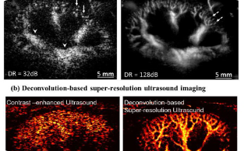
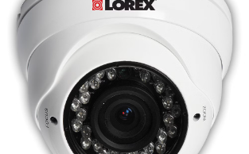
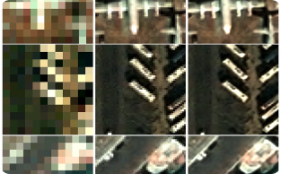
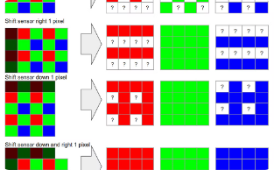
Applications of Super-Resolution GANs
Medical Imaging
Security and Surveillance
Remote Sensing
Digital Zooming
Enhancing resolution of MRI, CT, and other scans for improved diagnosis
Improving resolution of satellite and aerial images for terrain analysis
Enabling high-quality digital zoom on cameras and displays
Increasing detail in security footage for better identification of suspects

Slide 9
Limitations and Future Directions
Computational Cost
1
High training complexity
Artifacts
2
Potential for GAN-induced artifacts
Generalization
3
Challenges in generalizing to diverse data
Real-Time
4
Improving inference speed for real-time use
While GANs have shown promise for super-resolution, there are still key limitations that need to be addressed. The high computational cost of training these models is a challenge, as is the potential for GAN-induced artifacts in the output. Improving generalization to diverse datasets and increasing inference speed for real-time applications are also important future directions.

Slide 10

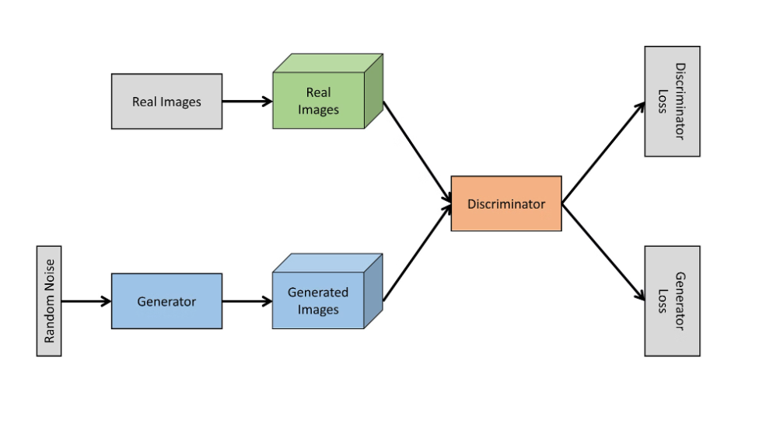
Conclusion and Key Takeaways
In conclusion, GANs have revolutionized super-resolution, enabling enhanced image quality.
Key takeaways: GAN models overcome challenges, achieve state-of-the-art performance, and enable diverse applications.

